Slide 1

CROP PRODUCTION ANALYSIS IN INDIA

Slide 2
Introduction
Crop Production Analysis in India
This data report provides an in-depth analysis of crop production patterns across India. By examining key data points, we can gain valuable insights to optimize agricultural strategies and drive sustainable growth.
The analysis covers a comprehensive overview of the data, including an examination of specific crop types, seasonal trends, and regional variations. This holistic view allows us to identify crucial factors impacting crop production and uncover opportunities for improvement.
By expanding our understanding of the complex dynamics shaping India's crop production landscape, we can empower farmers, policymakers, and stakeholders to make more informed decisions. This will ultimately support the goal of achieving greater food security, economic stability, and environmental sustainability in the agricultural sector.

Slide 3
Data Overview
Data Sources
Comprehensive dataset includes information on crop, crop year, area, season, production, district, and state.
Key Metrics
Analyze area under cultivation, total production, and crop yield to uncover trends and opportunities.
Timeframe
Data covers multiple crop seasons and years, enabling the identification of long-term patterns.

Slide 4
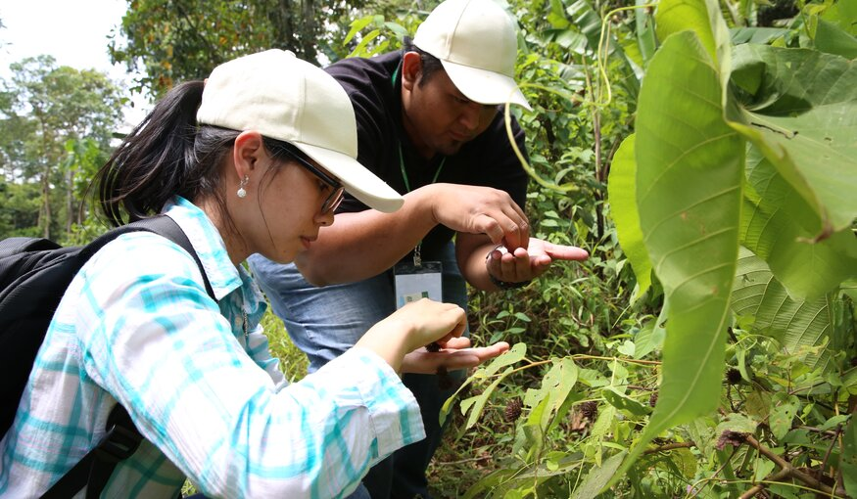
Crop Analysis
Crop Diversity
Examine the range of crops grown across different regions, from staple grains to high-value cash crops.
Crop Performance
Identify top-performing crops in terms of area, production, and yield to prioritize investments and support.
Crop Production
Spot new crop introductions and shifts in crop patterns that may signal changing market demands or environmental factors.

Slide 5

Seasonal Trends
Kharif Season
Analyze production and yield data for crops grown during the monsoon season, such as rice, maize, and sorghum.
Rabi Season
Examine trends for winter crops like wheat, mustard, and vegetables, which benefit from cooler temperatures.
Summer Season
Explore the performance of summer crops, including fruits, vegetables, and short-duration pulses.

Slide 6
Production Insights
Production Trends
Analyze overall production levels, noting any significant increases or decreases over time.
Productivity Drivers
Identify key factors that influence production, such as irrigation, fertilizer use, and adoption of improved technologies.
Crop Diversification
Explore the potential for diversifying crop portfolios to reduce risks and enhance food security.
Sustainability Goals
Align production strategies with national objectives for sustainable agriculture and environmental protection.

Slide 7
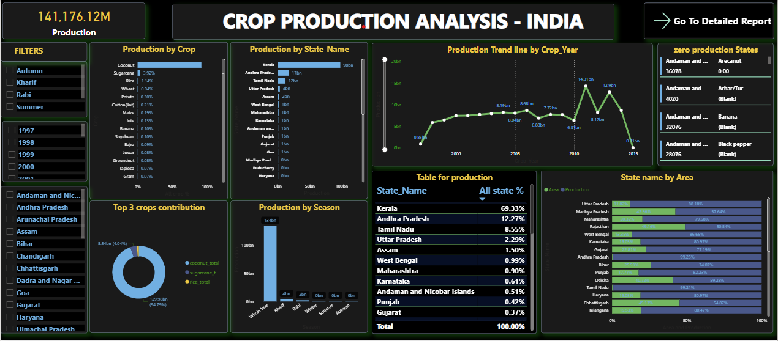
DASHBOARD

Slide 8
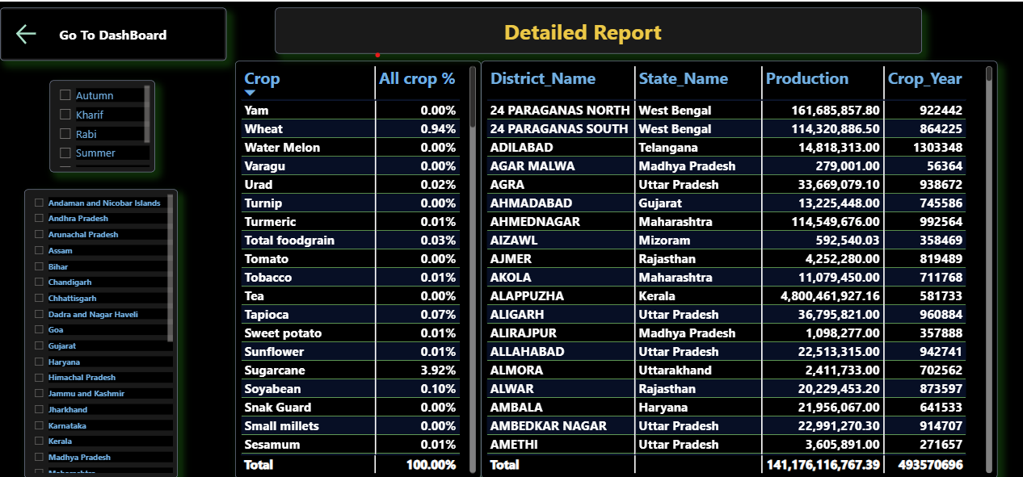
Detailed Report

Slide 9
Conclusion and Recommendations
Key Insights
Summarize the main findings from the analysis, highlighting significant trends, challenges, and opportunities.
Strategic Recommendations
Propose actionable strategies to optimize crop production, address regional disparities, and enhance agricultural sustainability.
Future Outlook
Provide a forward-looking perspective on the potential impact of technological advancements, policy changes, and emerging market demands.

Slide 10
THANK YOU

